Slide 1


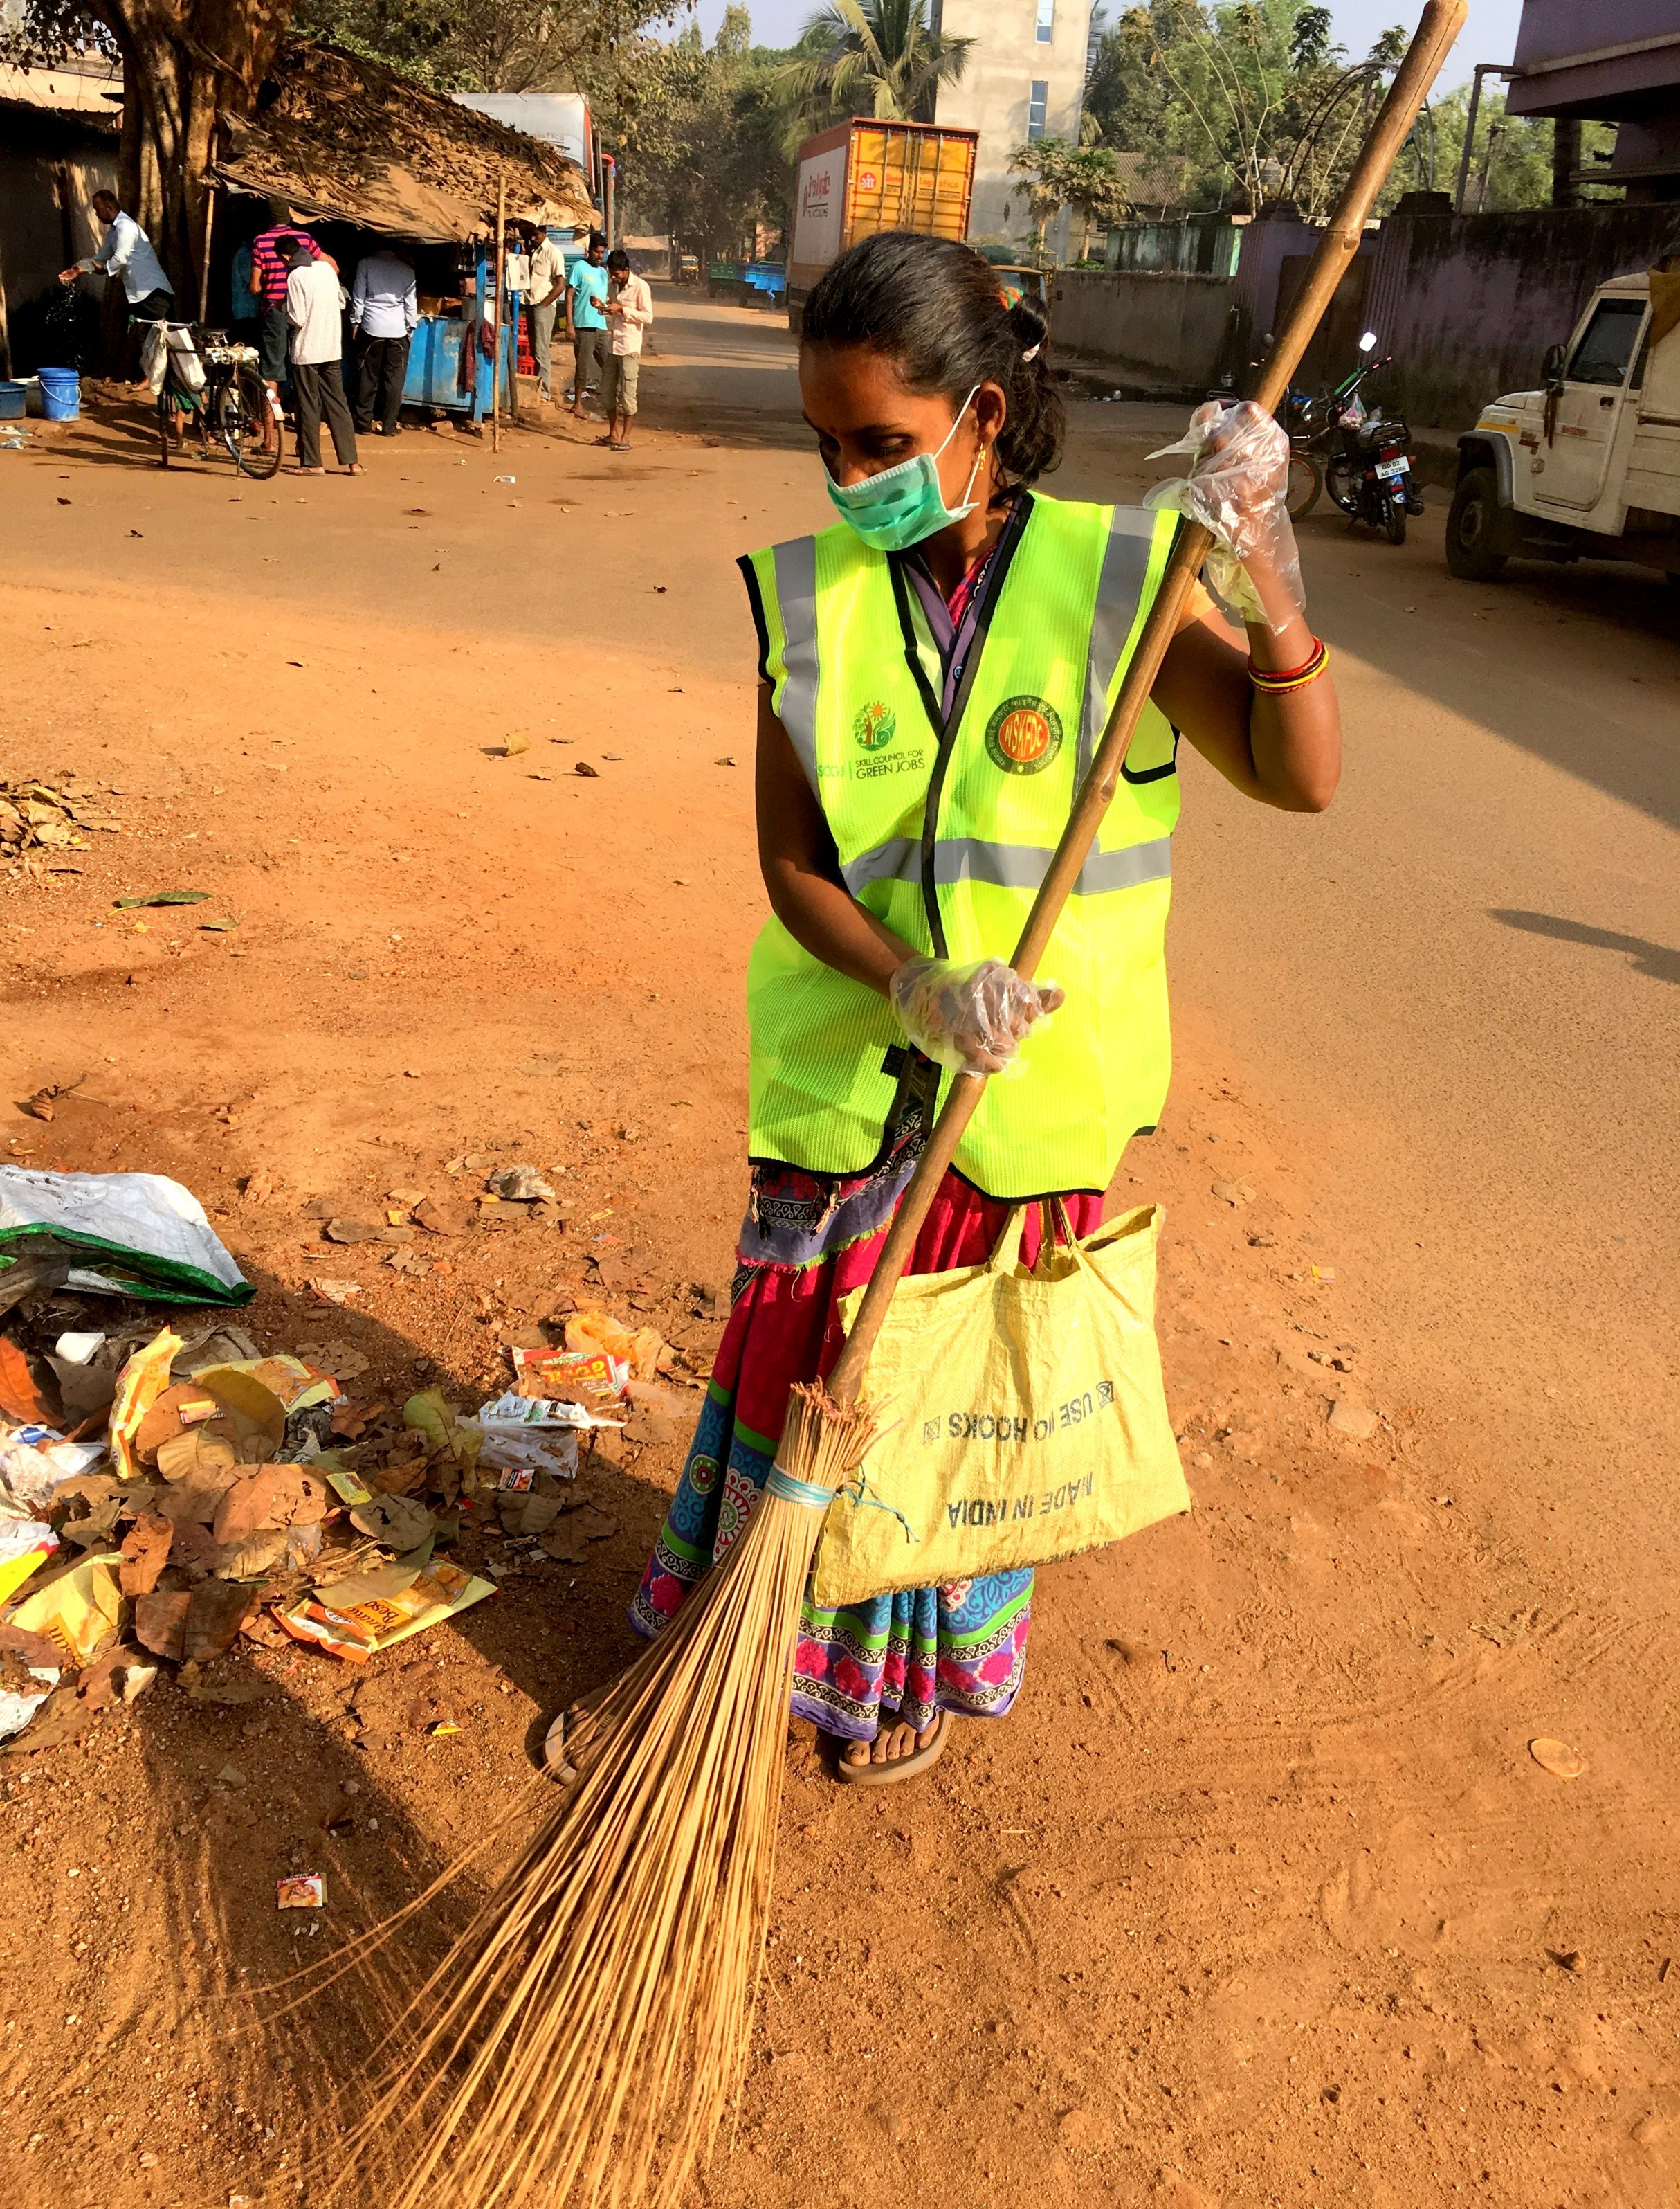

User Guide
SCGJ/Safai Karamchari – App
https://www.scgjsksd.in

Slide 2
Table of content
1. General Information…………………………………………………………………………………………………………Page 1
System Overview
2. Application Login……………………………………………………………………………………………………………..Page 2
Instructions
3. Admin Dashboard…………………………………………………………………………………………………………….Page 3
4. View Documents………………………………………………………………………………………………………………Page 4
Steps to find the documents uploaded by Training Partner
5. Generate Credentials……………………………………………………………………………………………………….Page 5
Steps to follow to generate credentials for training partners
Steps to follow to view the generated credentials for training partners
7. Update Targets…………………………………………………………………………………………………………………Page 6
Steps to follow to update targets
Steps to follow to search the updated targets

Slide 3
Page 1
General Information
SCGJ/Safai Karamchari - App is a web application which will be used by Skill Council for Green Jobs and its training partners as an operational and monitoring tool to carry out training of Safai Karamchari pan India. Due to the increase in the number of candidates being trained all over the country, it becomes difficult to manage all the information manually and maintain records in the excel sheets. This tool will help the training partners to generate different reports and excel sheets through the system and send it to the skill council which was earlier done manually. This tool will reduce the redundancy that exists in the current system where the training partner used to create different excel sheets for the same candidates where he had to enter the same information several times.
System Overview:
The application has been divided into the following parts:
Skill Council’s View
Online creation of user credentials and target allocation for training partner by SCGJ via – Generate Credentials
Functionality to view the documents uploaded by the training partner via – View Documents
Real – Time monitoring of accurate data and statistics via – Dashboard
Functionality to update targets of Training Partners
Training Partner’s View
Functionality to import data into the system via – Data Import
Automated Report Generation for batches via – Generate Report
Functionality to upload reports and documents for SCGJ via – Upload Documents
Personalised dashboard for training partner for monitoring purpose

Slide 4
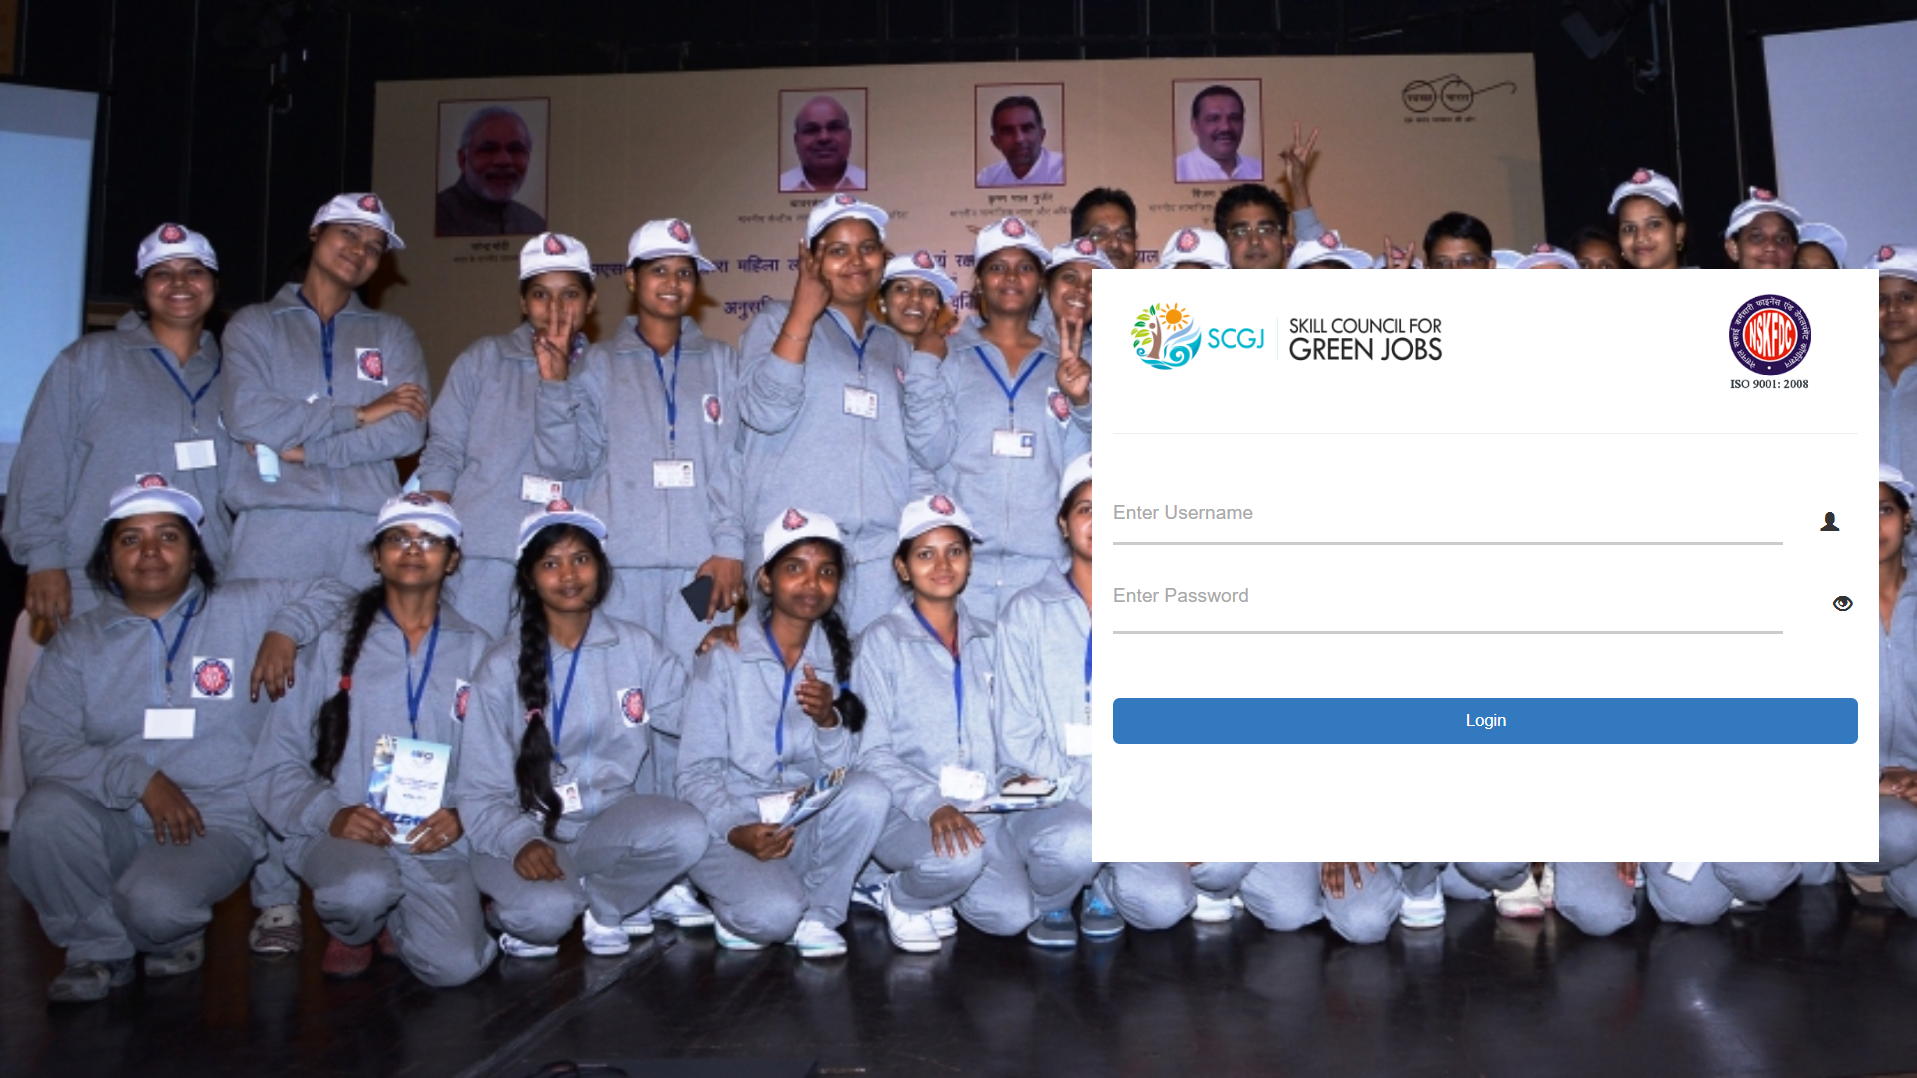
Page 2
Application Login
The login screen of the application will provide the role-based logins for both the Admins and the Training Partners
Instructions
To login to the application please follow the given steps:
Enter the link on the web browser as https://www.scgjsksd.in and click enter
A login screen as shown in the figure will appear on the screen
Enter the Email ID and Password
You can also click on the eye icon (Password Visibility) to check the password
After entering the details click on the login button
After clicking on the login button if you are an authentic user then you would be directed to your respective screens

Slide 5
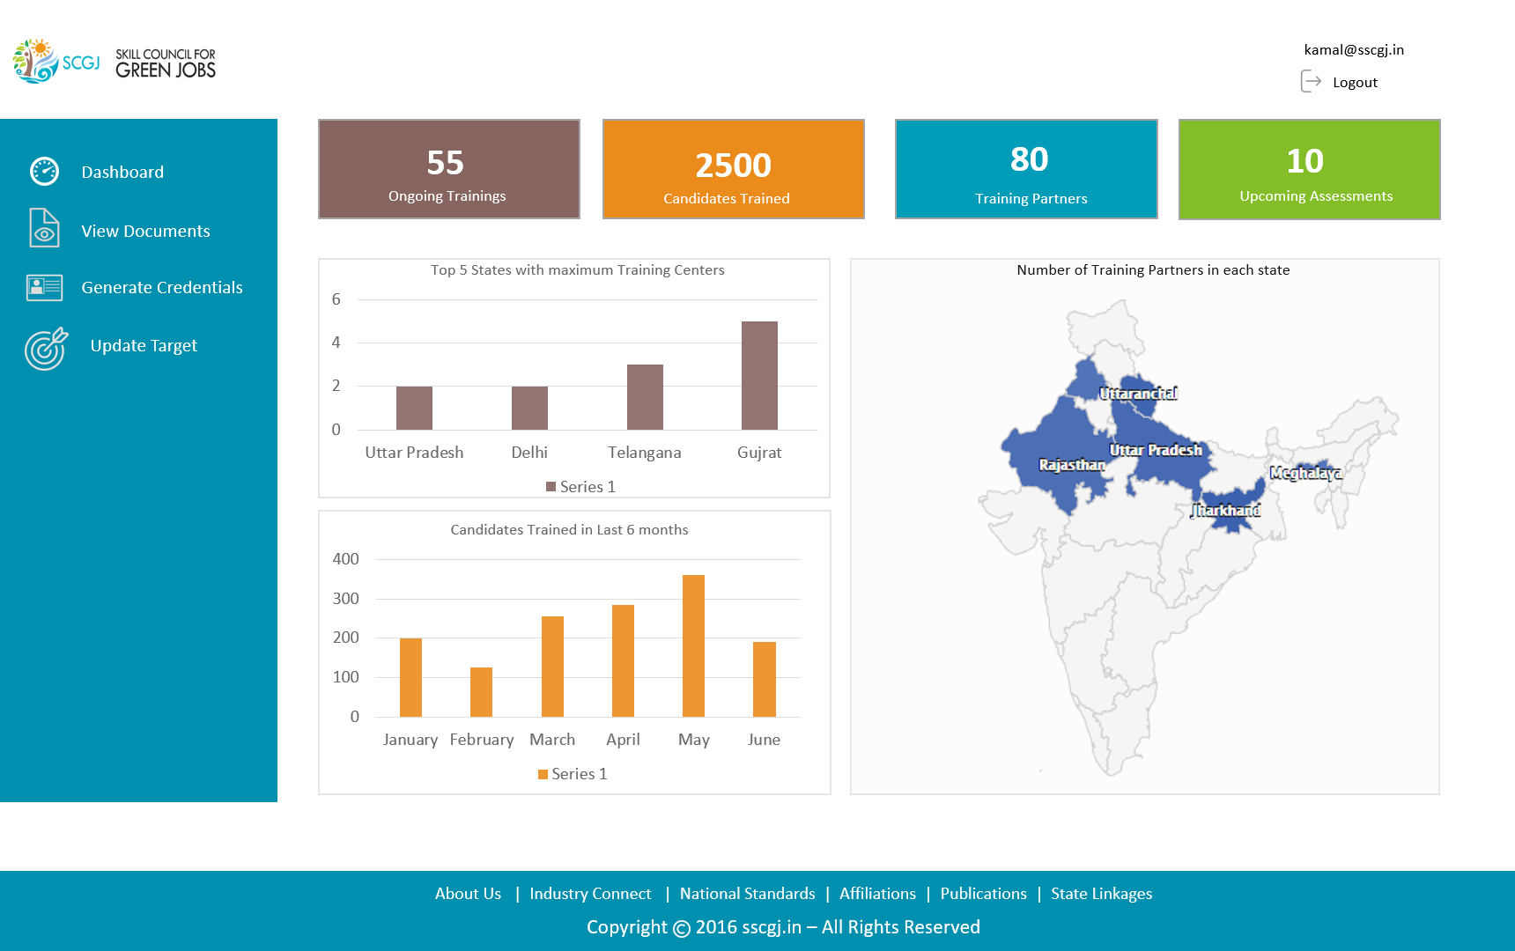
Page 3
Admin Dashboard
Dashboard of SSDMS is the part of the application where most important data would be available in the form of statistics and infographics. This module will contain information such as:
Ongoing Training(s)
Candidates Trained
Training Partners
Upcoming Assessments
The information is also available in the form of infographics which includes
Top 5 states having maximum training centres
Candidates trained in last 6 months
Training Centers in each State

Slide 6
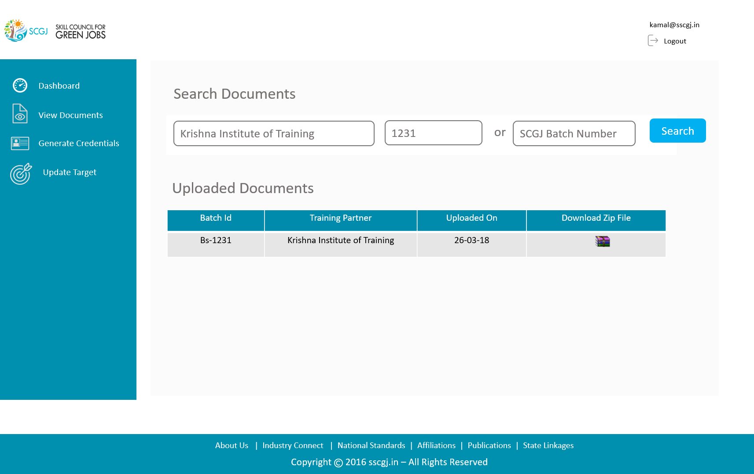
Page 4
View document
View Documents functionality will be used by the SCGJ Admin to view the documents that have been uploaded by the training partners.
Steps to find the documents uploaded by Training Partner
Please follow the following steps to find the documents uploaded by the training partner:
Navigate to the View Documents page
In the search documents section, Enter the name of the Training Partner
Enter the Batch Id or the SCGJ batch Number for which the documents are needed
Click on the Search Button
The table under the Uploaded Documents section will be populated with the result if the training partner has uploaded documents for that batch ID
Click on the zip icon to download the zip
A zip file will be downloaded which will contain all the documents that have been uploaded by the training partner

Slide 7
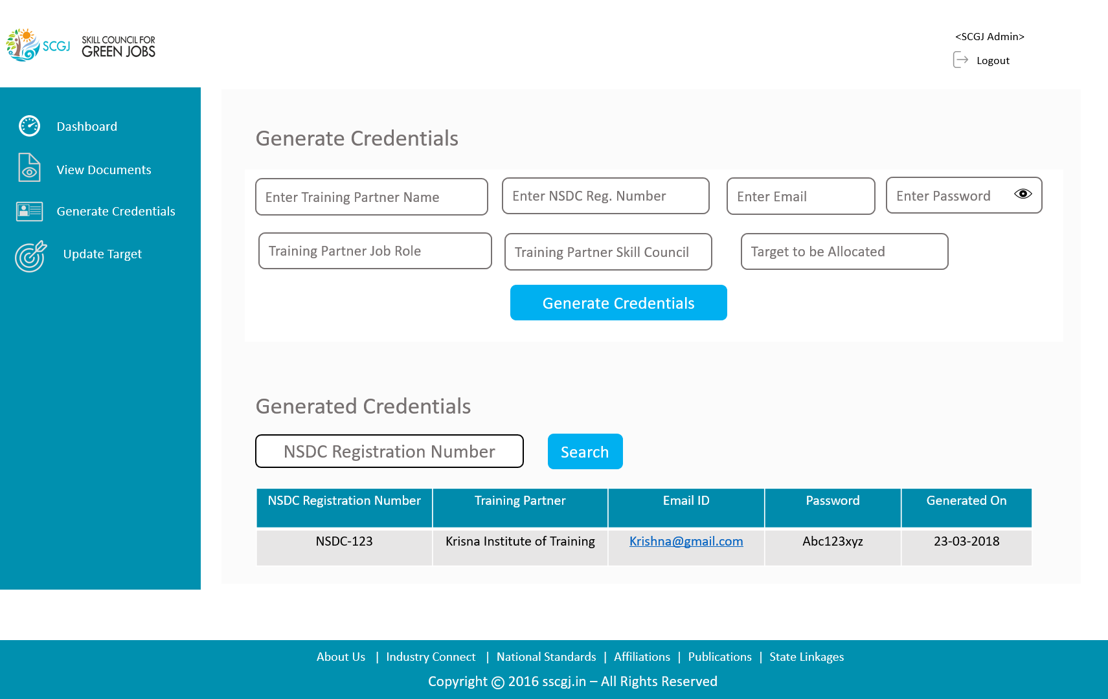
Page 5
Generate Credentials
The Generate Credentials functionality will allow the SCGJ Admin to generate Credentials for the Training Partners
Steps to follow to generate credentials for training partners
Please follow the given instructions to generate credentials for training partners:
Navigate to generate credentials section by clicking on generate credentials tab on left navigation
Under the Generate Credentials section enter the information given in text box
Enter the target which is to be allocated to the training partner for the current financial year
Click on the generate credentials button, A success message saying “User Credentials Generated Successfully” will be shown if the user is new in the system and if the user already exists then an error message saying “User Already Exists” will be populated
Steps to follow to view the generated credentials for training partners
Please follow the given instructions to view the generated credentials for training partners
Under the Generated Credentials section, Enter the NSDC Registration Number
After entering the NSDC Registration Number and click on the Search Button
The details of the credentials generated for the training partner will be displayed in the below table

Slide 8
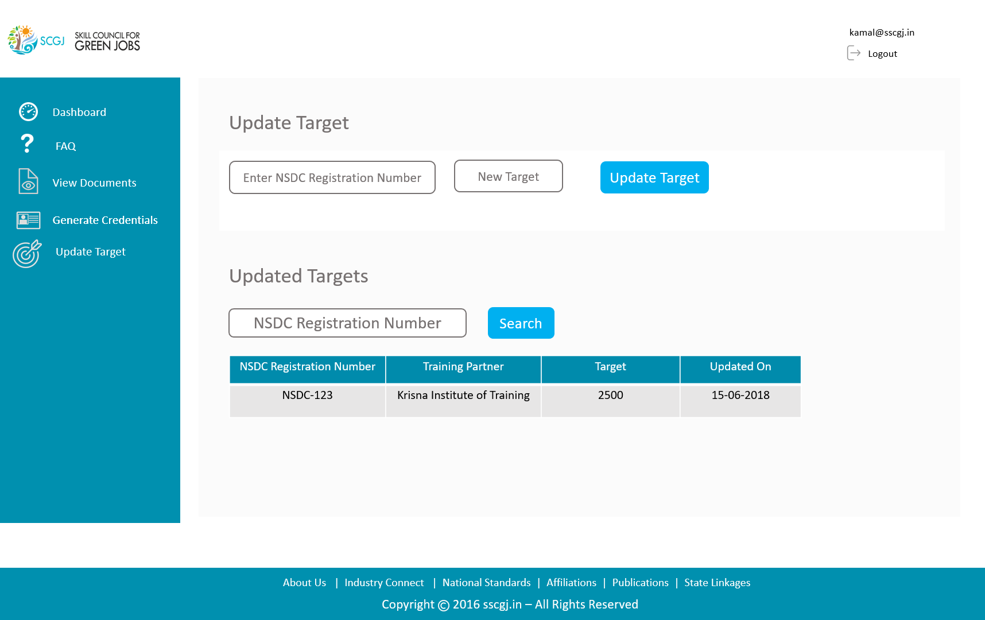
Page 6
Update Targets
The Update Targets functionality will be used by the SCGJ Admin to update the targets of the training partner for the current financial year by entering the NSDC Registration Number and the Targets
Steps to follow to update targets
Please follow the given steps to update the targets of Training Partners:
Navigate to the Update Targets tab by clicking on the update targets tab from the left navigation
Under the Update Target section, Enter the NSDC Registration Number and New Target for this financial year
After entering the new target click on the Update Target Button
If the targets are updated a success message saying, “Targets updated successfully!” will be populated and if the NSDC Registration Number of the Training Partner does not exists in the system then an error message saying “Training Partner with NSDC Reg. Number does not exists” will be populated
Steps to follow to search the updated targets
Please follow the given steps to search for the updated targets:
Under the Updated Targets Section, Enter the NSDC Registration Number and click on Search Button
The result of the updated targets will be populated in the table

Slide 9

Smalt and Beryl
Technology Business Incubator, ABESIT Campus 2, NH24, Vijay Nagar, Ghaziabad, U.P. 201009
www.smaltandberyl.com
info@smaltandberyl.com
+91 8290125695
Follow us on:

